Slide 1

WELCOME

Slide 2
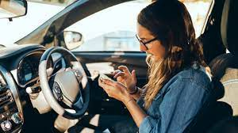
Driver Behavior Detection
Driver Behaviour Detection using CNN
Prevent accidents and enhance driving experiences.

Slide 3
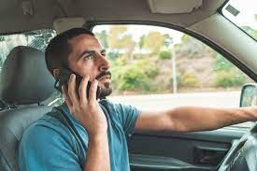
Problem Statement
In India Around 1.5 million lives lost every year
Globally, at least one life is lost every 24 seconds Ref: The Times of India

Slide 4

Accident Cases
1
Case Study 1
Texting on Phone
Driver distraction led to a collision.
2
Case Study 2
Talking on Phone
A loss of vehicle control.
3
Case Study 3
Other Activities
lane changing led to a side collision

Slide 5
Objective
The objective of driver behavior detection is to monitor, analyze, and understand how individuals operate vehicles on the road.
The primary goals of driver behavior detection.

Slide 6
Dataset :
Other Activities
Talking on Phone
Engaging in distracting activities while driving
Using a mobile phone without hands-free
Texting on Phone
Turning
Texting or browsing on a mobile device
Making unsafe turns or lane changes

Slide 7
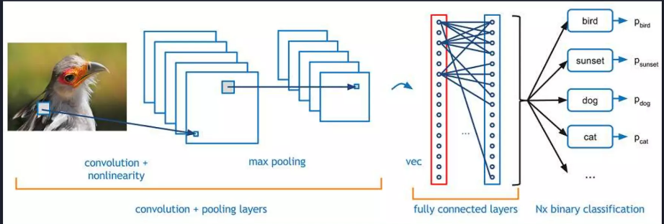
CNN Model

Slide 8

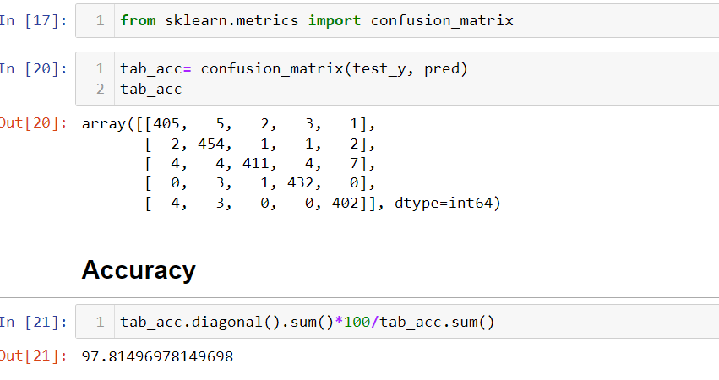
Model:

Slide 9
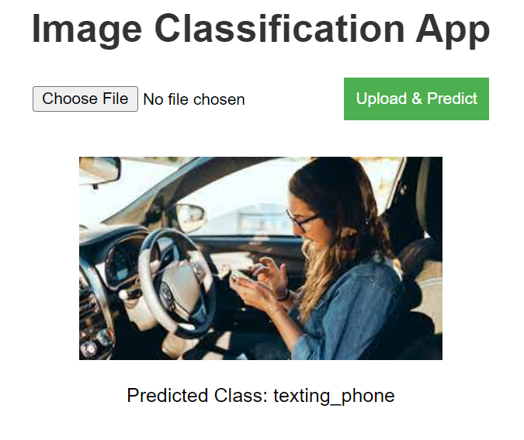
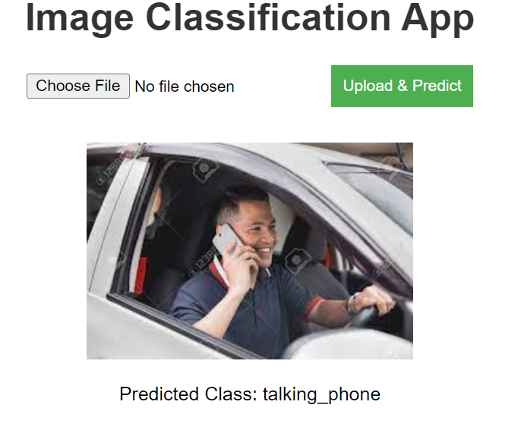
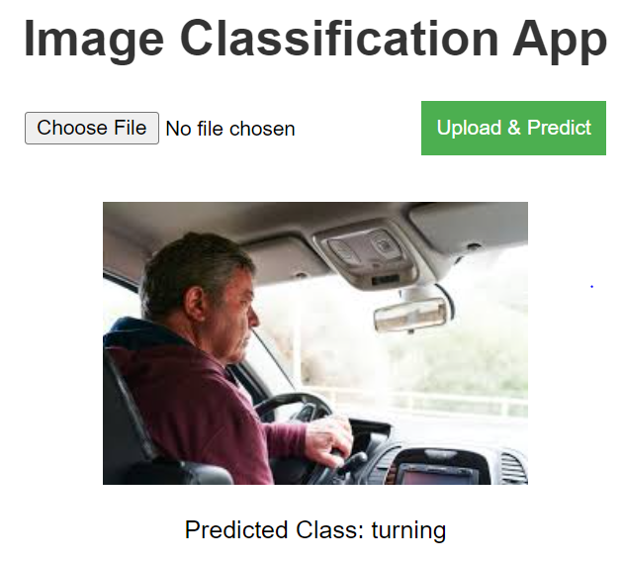
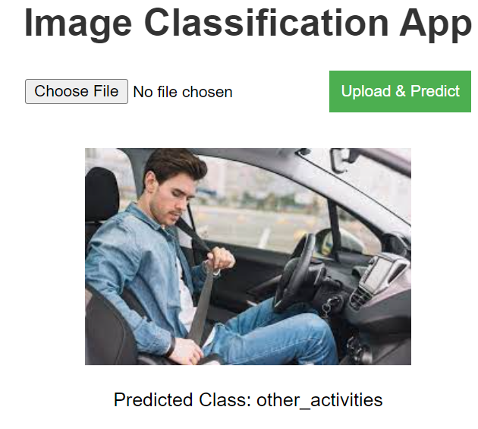
Output:

Slide 10
Advantages of Driver Behavior Detection
Real-time Alerts
Behavior Analysis
Instant notifications for risky driving behavior
Deep insights into driver actions and habits
Accident Prevention
Early detection and intervention to prevent collisions

Slide 11
Applications of Driver Behavior Detection
Vehicle Safety
Insurance Analytics
Road Accident

Slide 12
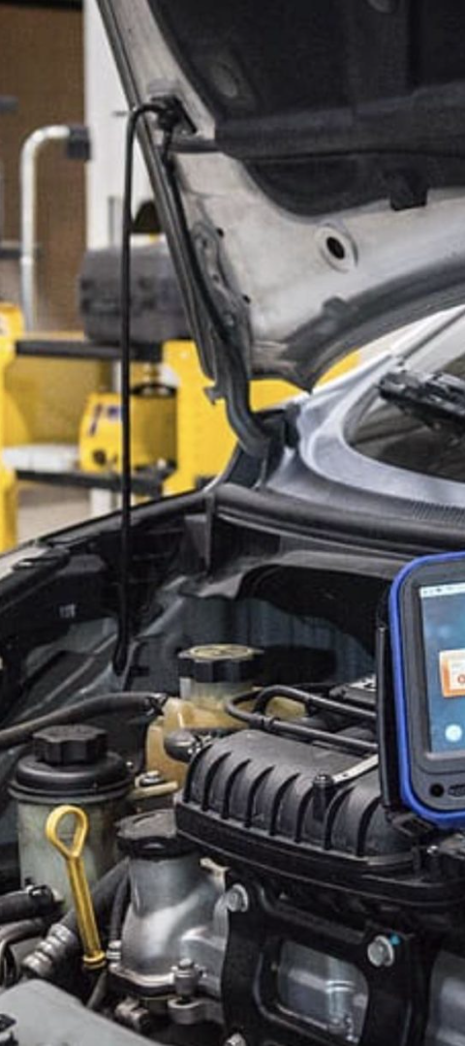



Future Scope
Advancements in AI
Integrating advanced AI for real-time driver monitoring.
Smart Dashboards
Interactive interfaces for immediate driver feedback.
Autonomous Car
Integration with autonomous driving technologies.

Slide 13
Conclusion
Driver Behaviour Detection using CNN is a promising technology for preventing accidents and improving the overall driving experience.

Slide 14
Thank You

